Slide 1
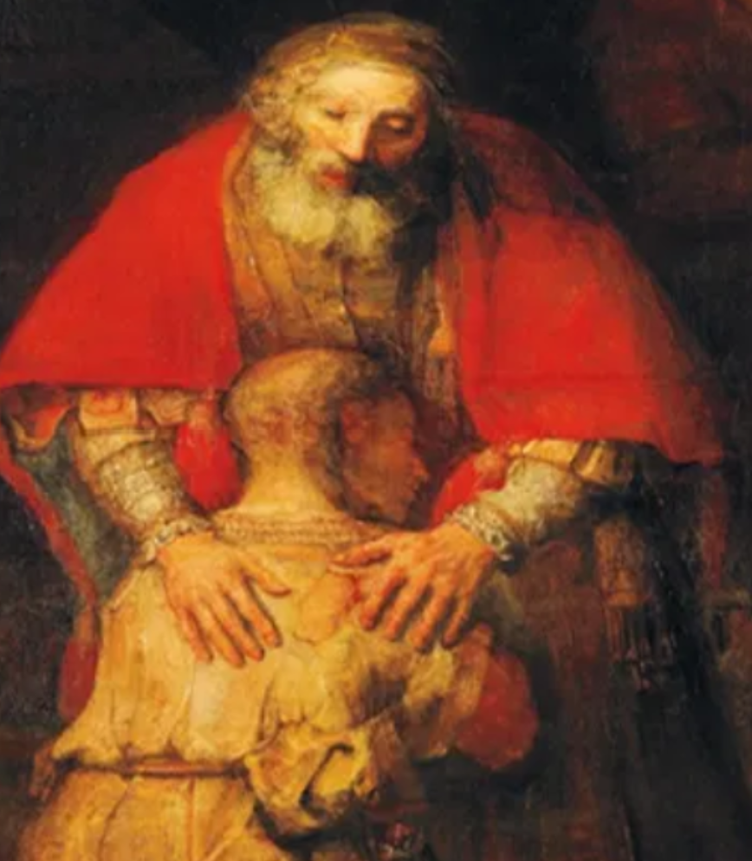
“Here I Stand”
Lutherans Finding Their Voice in Christian Apologetics
18th Annual Men’s Retreat
September, 2026
Notes:
Kierkegaard, speak a word…

Slide 2
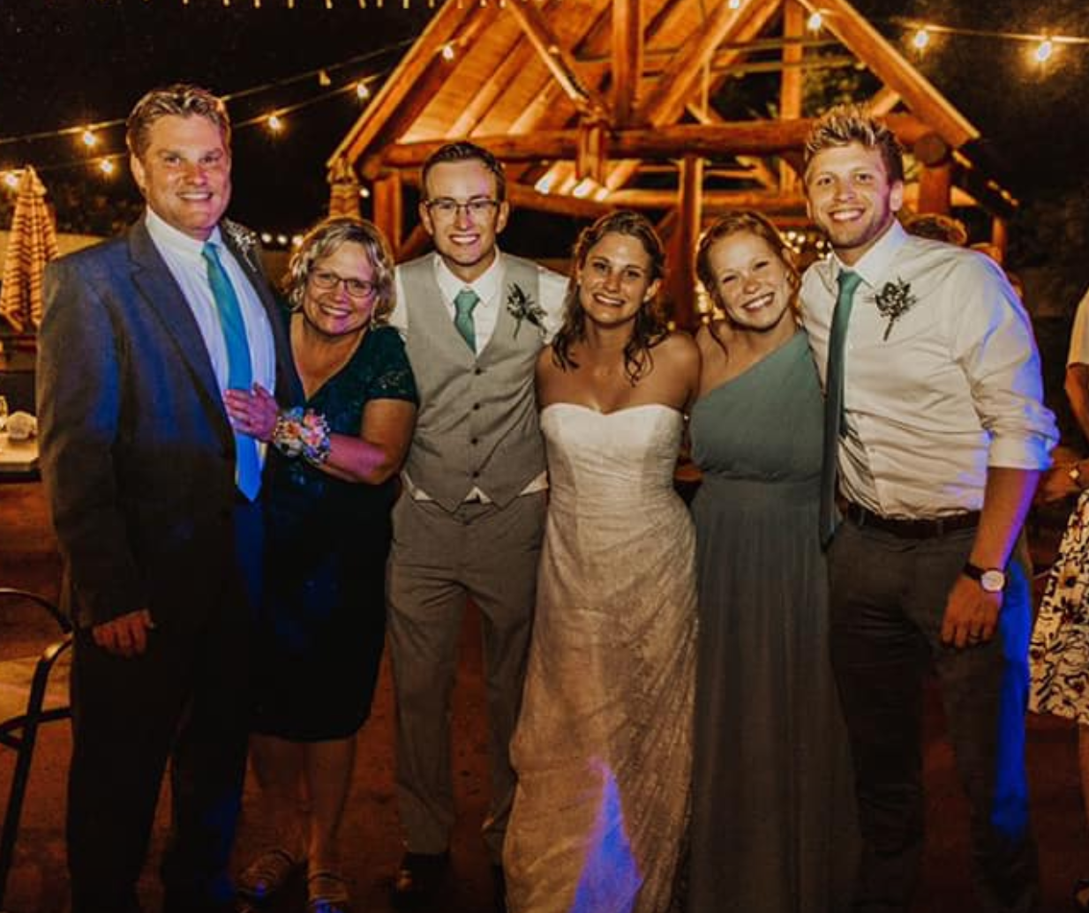
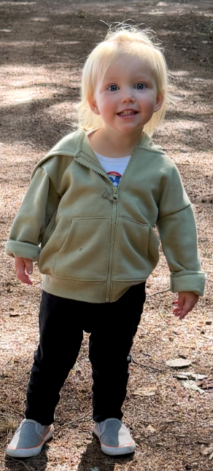

Slide 3
Opening Remarks
A story

Slide 4
Lutherans Finding Their Voice
“The weakness and foolishness of God…”
Session 1 On Christian Apologetics
Session 2 Talking to People
Session 3 Positive Apologetics
Session 4 Handling Objections
Session 5 Witnessing in Story / Q&A / Cushion Time
“From the fullness of the heart, the mouth speaks…”

Slide 5
Session One
The Big Picture

Slide 6
Some Lutheran
Distinctives
The nature of unbelief
The causes of faith
The role of reason
The 3rd Article

Slide 7
Christian Apologetics:
Defending Christian truth at “sites of struggle”
This can mean…

Slide 8
Christian Apologetics:
1) The Academic Discipline
How the Christian worldview functions among others in the scholarly arena. What can a Christian thinker who is a historian contribute, or a philosopher, or a psychologist, or a scientists…?
There is in this realm a powerful Lutheran distinctive.

Slide 9
An apologetic of the hiddenness of God
“Flee the hidden God and run to Christ.”
We note, in Luther’s expression, that God hides behind “masks” where only faith can find him. This creates a useful distinction between what can be investigated empirically on the basis of evidence and what we have no business trying to prove or verify with human reason.

Slide 10
Christian Apologetics:
2) Negative Apologetics
In our circles we have often limited our Christian apologetic to the use of human reason to dismantle skeptical challenges to Christian truth on their own terms.
“How much sense does it really make to say…”
Evil and suffering prove that God does not exist.

Slide 11
Christian Apologetics:
3) New Testament apologia
The apostle Paul “reasoned from Scripture” in the Jewish synagogue. The apostle Peter was “prepared to answer” in the face of hostile question; his answer was a testimony to his hope in Christ on the basis of what he had personally witnessed.

Slide 12
One Approach
It is not that the atheist or secular materialist has pure reason while believers have faith. Atheism is another set of beliefs, for examples, about matter. Nor is it the case that only believers have emotional reasons for wanting their beliefs to be true.

Slide 13
One Approach
In addition to some incredibly robust arguments we can make for Christian truth, we can compare these sets of beliefs:
Which is consistent with the things we experience, which are consistent within itself, which can be lived?

Slide 14
One Approach
We can demonstrate quite convincingly that universal experiences such as moral feelings and obligations or the human search for meaning make perfect sense within the Christian set of beliefs – they are just what you would expect – but sit uncomfortably in secular materialism.

Slide 15
One Approach
On Example
Social justice is a product of evolution or a societal consensus.
You can commonly find that secular people need to smuggle in beliefs from our Christian worldviews when it comes to moral obligation, identity, suffering, a crisis of meaning, and so on.

Slide 16
The longer and more deeply you think through and think about the implications of your worldview…
These are the sorts of severe problems that come with being secular. Consider the profoundly superior resources that Christians have.
Morality
Meaning
Suffering
Identity
Hope
Consider the “Subtraction Story”
All these reasons why a person might want Christ to be true, too, are apologia

Slide 17
Things that don’t interest us
Raising up “Apologetic Geniuses”
The “second Judas’ kiss”
Theodicy & Fideism
Supplanting the Word of God
Reading God’s Hidden Mind
Avoiding being fools in this world
Softening the scandal of the cross

Slide 18
Where our interest lies
Apologetics as
“Another Form of Bringing Good News”
Speaking like the apostles
An “Apologetic of the Word”
“Faith seeking understanding”
Loving God with all our Minds
How the vulnerable among us survive
Falling back into “the thing itself”

Slide 19
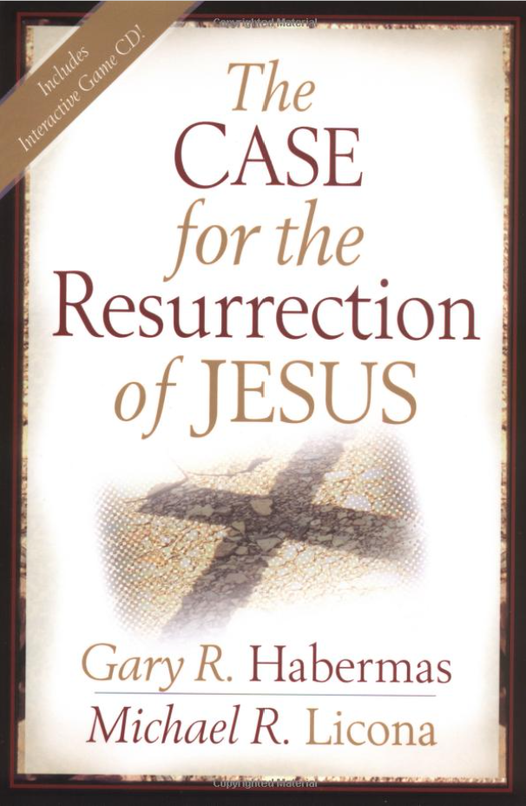
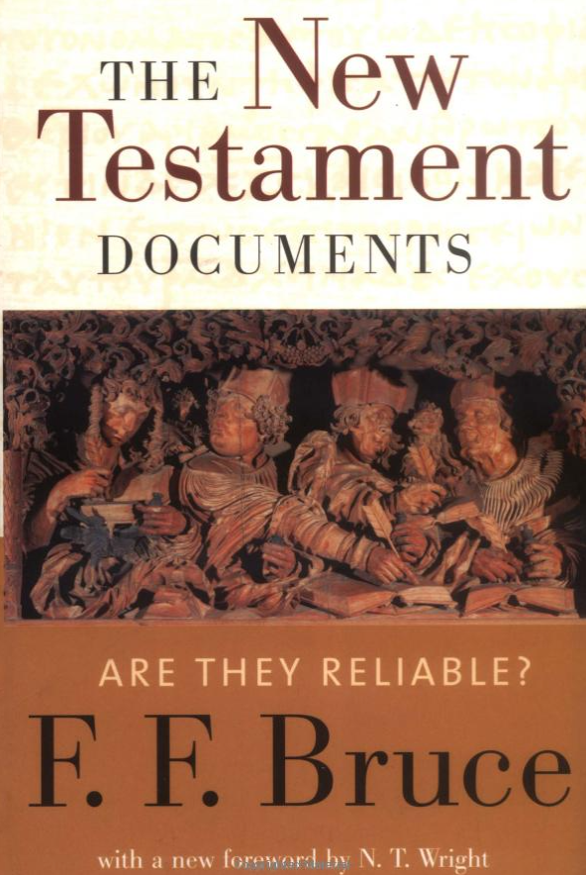


With any random extra minutes near the end of any session, I’ll just recommend books…

Slide 20



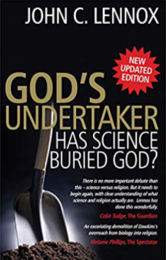

Slide 21



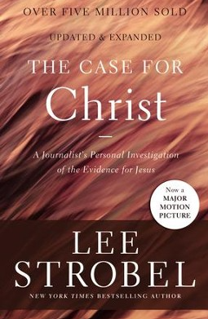

Slide 22
Session Two
Talking to People

Slide 23
In this session
How to talk to people…about Jesus
Opening up spiritual conversations
Asking good questions
The flow of the apologetic conversation
Preview to handling objections
The soft apologetic
The underlying goal:
To be the kindest person in the room (Romans 12)
Consider the “performative contradiction”
Think about what will remain in someone’s memory long after they’ve forgotten the details
We’ll talk all around these issues and have time fo you to react and explore which ones matter to you

Slide 24
How to talk to people…
Curiosity – “Let each one not look to her own interests…”
High Regard – “Consider others better than yourselves…”
Sharing – “We were pleased to share our very lives…”
Investing – “Carry each other’s burdens..”

Slide 25
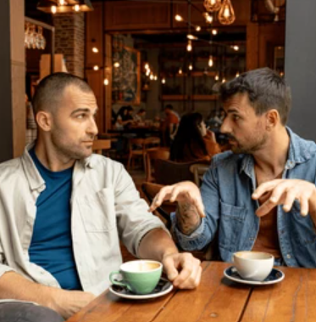
…about Jesus
Be transparently Christian
Ask good questions
Really see and really hear them
Bring Christ in

Slide 26
Where to start? How can we find ourselves in spiritual conversations?
Grice’s Maxims are a rule-based approach to conversation. Like the game of chess, if you don’t know the rules you can’t play.
Let’s consider the “relevancy maxim.”
Because you can absolutely prepare these in advance of any conversation.
All these are real.
“So…I’ve got this song stuck in my head…you know how that happens…”
All these are real.
“So…I found myself praying for you the other night…”
All these are real.
“So…here’s something I can’t believe we’ve never talked about…”
All these are real.
“Do you mind if I ask you something? Do you believe in God?”
All these are real.
“So…my pastor told this great story last Sunday…”
All these are real.
“So…I stumbled across this amazing thing in my Bible this morning…”
All these are real.
“You know what’s been on my mind a lot lately?”
All these are real.
“So…last time we talked you said something I can’t stop thinking about…”
All these are real.
“So…I’m reading an incredible book…”
All these are real.
“So…I noticed you were having a tough time of it the other day, and I wanted to encourage you somehow but I wasn’t sure…”

Slide 27
…about Jesus
Be transparently Christian
Ask good questions
Really see and really hear them
Bring Christ in

Slide 28
IVA
Identify
What feelings are present?
Validate
It’s only human to feel these things
Align
Now, What’s True?
We seek the wisdom and courage to ask powerful “backyard” questions.
“So how are you?…okay…so how are you?”
“I bet there’s a story that makes this (anxiety, sadness, anger) makes sense?”
“So you’re not in control of the things that matter most to you. What does that do to you?”
“What are you hoping for in life?...okay…so what if that never happens?” What makes life worth living?...okay…so what about when that’s gone?”
And the home run is when the questions come back to us.
“Always be prepared to give an answer…”

Slide 29
…about Jesus
Be transparently Christian
Ask good questions
Really see and really hear them
Bring Christ in

Slide 30
“Professor Paustian, I remember one thing from IPC” (interpersonal communication class)…
Seek first to understand, then, and only then, to be understood.
Consider the huge degree to which the pressure is off!

Slide 31
“Religion is a crutch for the weak”
Active listening means…
Brief content paraphrases: “So you’re saying…”
Reflection of feeling: “You seem…”
Open questions: “Help me understand this…”
What do you mean by…
How have you come to think that’s true?
Have you considered…
“The church is full of hypocrites.”
And you say?

Slide 32

…about Jesus
Be transparently Christian
Ask good questions
Really see and really hear them
Bring Christ in

Slide 33
The beauty and reality
of Christ
transparently
communicated
You speak in such a way that although the skeptic may not believe a word of it, they will understand why a person could at least begin to want it to be true.

Slide 34
Expose and gently
deconstruct
their particular
Defeater
The point is not to win arguments or prove Christian truth, only to once shake their confidence in their patterns of resistance…

Slide 35
Open the
Word of God
to articulate Christian truth.
…that the Word of God and the story of Christ should gain entrance in a person’s mind so that the Spirit might do what only he can.

Slide 36
The beauty and reality
of Christ
transparently
communicated
Expose and gently
deconstruct
their particular
Defeater
Open the
Word of God
to articulate Christian truth.
Let’s unpack that middle piece some more.

Slide 37
What is a “Defeater?”
A defeater is a thought in someone’s head that, if true, Christ, as Scripture reveals him, cannot be. It often has a taken-for-granted quality. It feels self-evidently true. And it may, for the person, go mostly unexamined.
If it were true that a loving God could not send someone to hell, then Christian truth itself is cancelled.
Note how these vary for different places and times.
If Belief A is true, then Belief B does not need to be considered.
If a loving God could never allow evil and suffering, then one need not give Jesus another thought.

Slide 38
2 Corinthians 10
¹By the humility and gentleness of Christ, I appeal to you….
³ For though we live in the world, we do not wage war as the world does. ⁴ The weapons we fight with are not the weapons of the world. On the contrary, they have divine power to demolish strongholds. ⁵ We demolish arguments and every pretension that sets itself up against the knowledge of God, and we take captive every thought to make it obedient to Christ.

Slide 39
Greg Koukl’s, Tactics
How the ambassador for Christ can remain non- adversarial
How any Christian can begin to do apologetics today
How to drain most of the anxiety out of the situation
Notes:
.

Slide 40
Greg Koukl’s, “Columbo” Approach
You might remember the rumpled detective from the old television show. He asked a ton of questions, typically, “There’s something I still don’t understand. Can you help me?”
Here’s the big idea. We can stay in these first two modes as long as we like, resolving simply to understand (not to mention, buying time). We don’t let a hostile skeptic turn the tables.
“What do you mean when you say __________? I really want to understand this.”
2) “How have you come to this conclusion? Why do you think that’s true?”
If the skeptic knows more than we do?
(There are millions of “shallow post-moderns” out there.)

Slide 41
When we’re ready we can ask a third kind of question that draws on our growing body of knowledge and the experiences we’re gaining.
Christian: “Well, may I ask if you’ve thought about ________? Were you aware that __________?

Slide 42
Role Play
Person A: “The church is full of hypocrites.”
Person B: “What do you mean by that?”
Person A: make something up
Person B: “What makes you think that’s true?”
Person A: make something up
Person B: “Well, have you thought about…?”
Or
“I can tell you’ve thought about this more than I have. Let’s talk about this again soon.”
“What do you mean when you say __________? I really want to understand this.”
2) “How have you come to this conclusion? Why do you think that’s true?”
3) “Well, may I ask if you’ve thought about ________? Were you aware that __________?

Slide 43
Evaluate Greg Koukl’s, Tactics
It may not be as easy as he makes it sound?
Or it may be that we are just “trying on a suit coat three sizes too big.”
Would this make a difference among us if we gave ourselves every chance to grow into these methods?

Slide 44
The beauty and reality
of Christ
transparently
communicated
Expose and gently
deconstruct
their particular
Defeater
Open the
Word of God
to articulate Christian truth.
An Apologetic of the Word

Slide 45
The beauty and reality
of Christ
transparently
communicated
Expose and gently
deconstruct
their particular
Defeater
Open the
Word of God
to articulate Christian truth.
There’s also a “Soft Apologetic”
And art, invitation, hospitality, and caring about what happens to people in this world – “as unanswerable as a sunrise.”

Slide 46
The beauty and reality
of Christ
transparently
communicated
Expose and gently
deconstruct
their particular
Defeater
Open the
Word of God
to articulate Christian truth.
There’s also a “Soft Apologetic”
“I know that God exists because JS Bach’s “St. Matthew Passion” exists.

Slide 47
The beauty and reality
of Christ
transparently
communicated
Expose and gently
deconstruct
their particular
Defeater
Open the
Word of God
to articulate Christian truth.
There’s also a “Soft Apologetic”
The apologetic of community, beauty, mystery...

Slide 48
How to talk to people…about Jesus
Opening up spiritual conversations
Asking good questions
The flow of the apologetic conversation
On “defeaters” and what they mean
An apologetic of The Word & the Soft Apologetic

Slide 49
With any random extra minutes near the end of any session, I’ll just recommend books…

Slide 52
Session Three
Positive Apologetic Arguments

Slide 53
Three CORE Issues
The Phenomenal Reliability of the New Testament
The Historical Fact of Christ’s Resurrection
The Necessity of God
These are not ultimately meaningful unless…
See the hand-out for a full list of twenty – appendix D p. 22
Shall we open it up? Anything on your mind?

Slide 54
Three CORE Issues
The Phenomenal Reliability of the New Testament
The Historical Fact of Christ’s Resurrection
The Necessity of God
These are not ultimately meaningful unless…
See the hand-out for a full list of twenty – appendix D p. 22
Shall we open it up? Anything on your mind?
We are living devotionally and growing in our sacred texts
We are vitally connect to Jesus by the Means of Grace
In the life that revolves around Christian worship.

Slide 55
Luke is a world-class historian charged with “habitual accuracy” and is credited with the profound falsifiability he brings to the question of New Testament reliability.
3 In the fifteenth year of the reign of Tiberius Caesar—when Pontius Pilate was governor of Judea, Herod tetrarch of Galilee, his brother Philip tetrarch of Iturea and Traconitis, and Lysanias tetrarch of Abilene— ² during the high-priesthood of Annas and Caiaphas, the word of God came…

Slide 56
Acts 26
Consider the nature of the Christian claim
Do people know this? Are you sure?
“Blessed are those who have not seen, but yet have believed.”
This is NOT belief without evidence.
²⁵ “I am not insane, most excellent Festus,” Paul replied. “What I am saying is true and reasonable. ²⁶ The king is familiar with these things, and I can speak freely to him. I am convinced that none of this has escaped his notice, because it was not done in a corner. ²⁷ King Agrippa, do you believe the prophets? I know you do.”

Slide 57
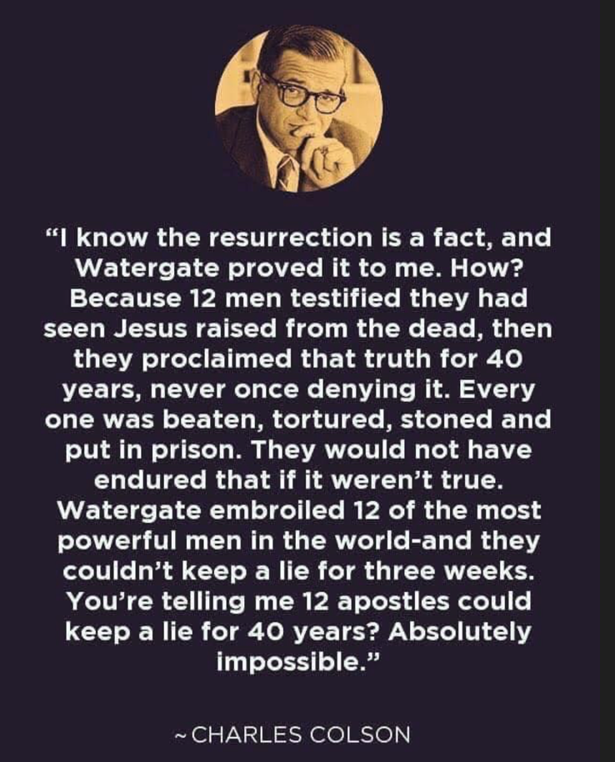

Slide 59
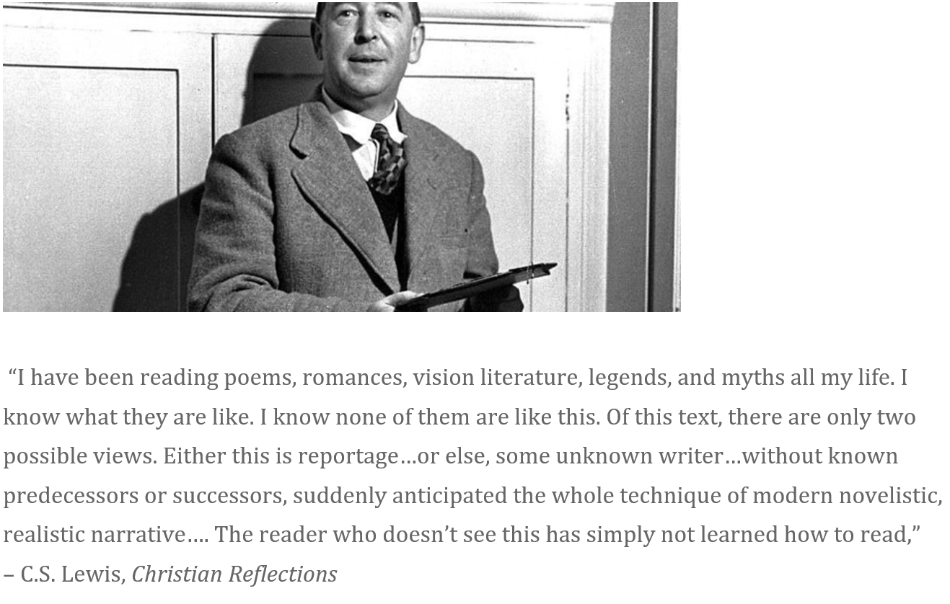

Slide 60
Jump in any time.
Or we can pause at the end.
Let’s take a quick look at the bulleted document on the Phenomenal Reliability of the New Testament (p. 18)

Slide 61
“The Minimal Facts” Approach
For the sake of argument, we can limit ourselves to conclusions that have almost total consensus among historians regardless of their presuppositions.
3400 scholarly publications were analyzed and over 500 prominent historians (of all points of view) were examined or interrogated to reveal the historical issues that are conceded my nearly all of them.

Slide 62
“The Minimal Facts” Approach
We can limit ourselves for the time being to New Testament texts whose veracity is not in doubt (e.g., about half of the epistles of Paul). This is only for the time being.
“Doggone it! It seems like he did it.”

Slide 63
“The Minimal Facts” Approach
A man known as Jesus Christ was executed by the Romans through crucifixion
Later, the disciples believed he appeared to them physically
The Conversion of the Persecutor Saul
The Conversion of the Skeptic James
The Empty Tomb
The authenticity of 1 Corinthians and Galatians is unquestioned.

Slide 64
If a foot represents a year…
The earliest evidence for the existence of Alexander the Great is a football field removed from his life.
We have the unimpeached testimony of Paul, a man known to history, from five or six feet (years) from Ground Zero. This is when he “historied” with Peter in Jerusalem (Galatians 1).

Slide 65
If a foot represents a year…
Skeptical New Testament scholars, including none other than Bart Ehrman himself, publicly acknowledge that the testimony of Christians in Jerusalem can be dated to two or three years after the resurrection of Jesus. Why?
In 1 Corinthians 15, Paul appears to be quoting a credal statement already in circulation by the time he was converted two or perhaps three years after Jesus rose.
So began the about-face of a brilliant man who retained his brilliance and mental clarity and maintained his confession at great personal cost to the end of his life.

Slide 66
1 Corinthians 15
For what I received I passed on to you as of first importance: that Christ died for our sins according to the Scriptures, ⁴ that he was buried, that he was raised on the third day according to the Scriptures, ⁵ and that he appeared to Cephas, and then to the Twelve. ⁶ After that, he appeared to more than five hundred of the brothers and sisters at the same time, most of whom are still living, though some have fallen asleep. ⁷ Then he appeared to James, then to all the apostles, ⁸ and last of all he appeared to me also, as to one abnormally born.

Slide 67
1 Corinthians 15
For what I received I passed on to you as of first importance: that Christ died for our sins according to the Scriptures, ⁴ that he was buried, that he was raised on the third day according to the Scriptures, ⁵ and that he appeared to Cephas, and then to the Twelve. ⁶ After that, he appeared to more than five hundred of the brothers and sisters at the same time, most of whom are still living, though some have fallen asleep. ⁷ Then he appeared to James, then to all the apostles, ⁸ and last of all he appeared to me also, as to one abnormally born.

Slide 68
1 Corinthians 15
For what I received I passed on to you as of first importance: that Christ died for our sins according to the Scriptures, ⁴ that he was buried, that he was raised on the third day according to the Scriptures, ⁵ and that he appeared to Cephas, and then to the Twelve. ⁶ After that, he appeared to more than five hundred of the brothers and sisters at the same time, most of whom are still living, though some have fallen asleep. ⁷ Then he appeared to James, then to all the apostles, ⁸ and last of all he appeared to me also, as to one abnormally born.

Slide 69
1 Corinthians 15
There is only one
crucified man
whose name you know. Why?
(Well, there’s Peter, too, but that doesn’t weaken the point.)
For what I received I passed on to you as of first importance: that Christ died for our sins according to the Scriptures, ⁴ that he was buried, that he was raised on the third day according to the Scriptures, ⁵ and that he appeared to Cephas, and then to the Twelve. ⁶ After that, he appeared to more than five hundred of the brothers and sisters at the same time, most of whom are still living, though some have fallen asleep. ⁷ Then he appeared to James, then to all the apostles, ⁸ and last of all he appeared to me also, as to one abnormally born.

Slide 70
Let’s take a quick look at the bulleted document on the Resurrection Apologetics (what’s behind some of the minimal facts, and other historical elements as well) (p. 22).
Jump in any time.
Or we can open it up at the end.

Slide 71
You can see a list of twenty additional positive arguments for the reality of Christ (p. 24f).
The phenomenon of prophecy, the historic advantage, “Liar, Lunatic, Lord,” and so on.
Let’s talk about the usefulness and limitations of the content, in general, from this session

Slide 72
With any random extra minutes near the end of any session, I’ll just recommend books…

Slide 75
Session Four
Handling Objections

Slide 76
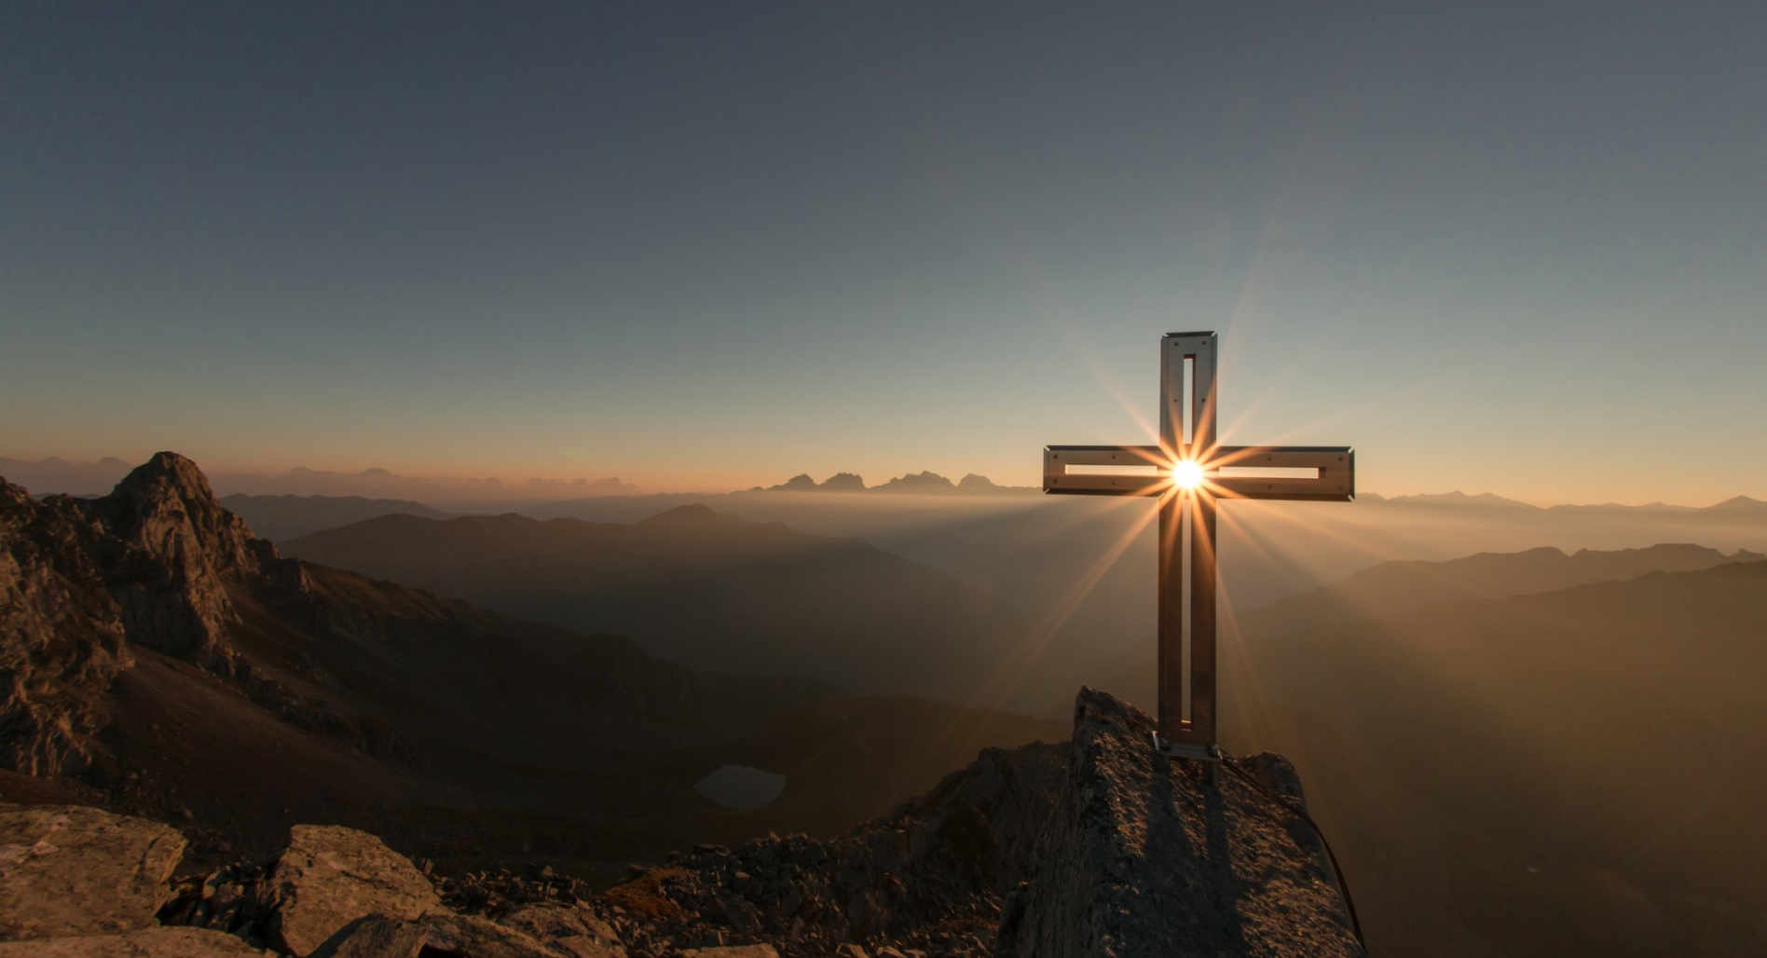
Tell me about the God you don’t believe in. Maybe I don’t believe in him either.

Slide 77
Christian Apologetics:
2) Negative Apologetics
In our circles we have often limited our Christian apologetic to the use of human reason to dismantle other worldviews and the particular objections that spring from them.
“How much sense does it really make to say…”
We’re already dispensed with three special “defeaters” in the last session:
If Christ is dead…
If my Bible cannot be trusted…
If there’s no reason to think God even exists…

Slide 78
Our Approach
We do not assume people know what Christian theology says in relation to the defeater or, for that matter, what the gospel is.
We do not fail to present a Scriptural argument, even if we aren’t quoting chapter and verse.
We do not labor to make that answer palatable or to remove the scandal.
We will honor the question, listen well, and speak transparently, (not with pat answers).
We will testify to Christ crucified and raised, as our one true subject.
Let’s talk about the “Mother of all Defeaters”
Then a bit about the path forward
Then we can open it up to discuss any other skeptical challenges that are on your minds (see the handouts)

Slide 79
Chew on this for five minutes in groups of at least three people.
There is too much suffering in the world to believe in God.

Slide 80
What might you want to know about the most common defeaters you happen to meet?
Who is saying it?
What do they really mean? What are the hidden assumptions?
Is it true in a way? What is the bigger picture the objection leaves us?
Where could it be coming from?
What false beliefs sit inside it?
Does it make any sense?
How is Christian theology implicated?
What sort of answer will make sense “out there?”
Why does it not get in the way for you personally?
What is the uniquely Lutheran, grace-saturated, sticky response?
A loving God could never send someone to hell.

Slide 81
Activity #1 Notecard Exchange
My Takeaway
Write a “takeaway” on the Front – something you’d like to make real, reflect on, deepen your understanding of, not forget… (plus your name)

Slide 82
Activity #1 Notecard Exchange
My Takeaway
A Question
Write a genuine question, if you have one, on the back. Push back any way you like, or pose something others might be wondering about, too.

Slide 83
With any random extra minutes near the end of any session, I’ll just recommend books…

Slide 86
Session Five
Witnessing in Story
Keenan
Q&A / Open Mic
The Devotional Life

Slide 87
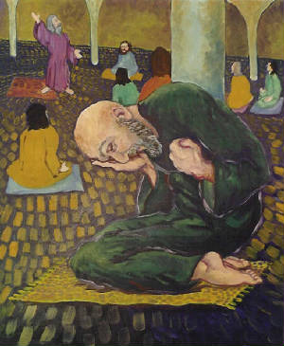
What is it about a good story?
How confident are you as Christ’s ambassador in this world?
What’s your favorite Gospel story?
“That reminds me of a story. Stop me if you’ve heard it.”
Do you hear yourselves?
What does it teach?
Why that story?
Who needs to hear this? For what question or situation is this a beautiful answer?
How would you tell the whole story to someone who doesn’t already know it?
What does it do to you?
What’s your Bible Story “Play List?”
What do you like about this big idea?
What makes you unsure about it?
What if you joined a group of “two or three” and each of you got comfortable telling three high impact stories with broad application?
Session Five
Witnessing in Story

Slide 88
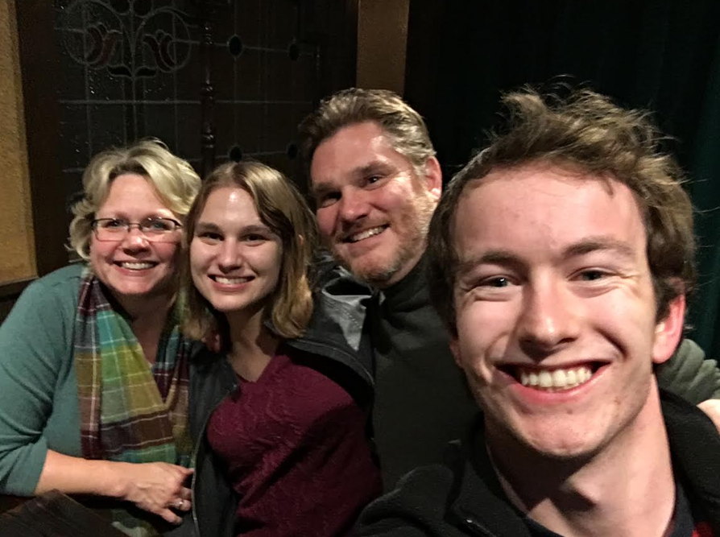

Slide 89
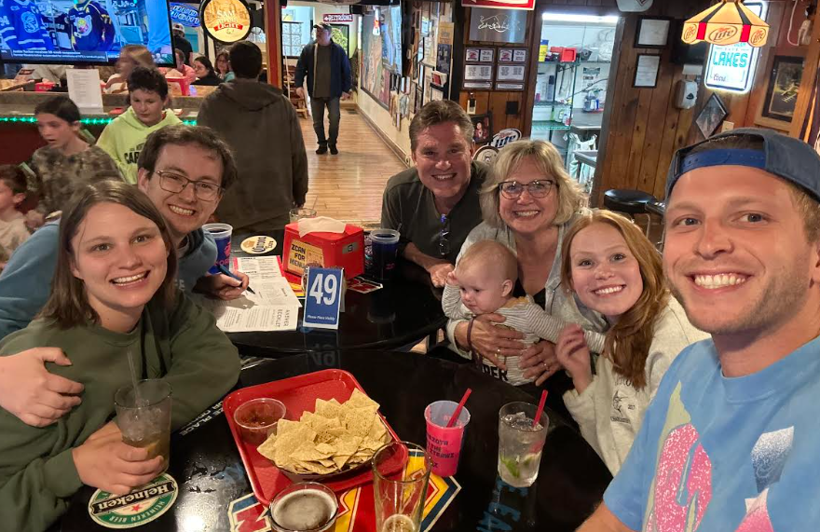
Explore my story?
Your encouraging stories?

Slide 90
Devotional
Living
Layering habits

Slide 91

Jesus, I am here, to enjoy your presence. My day can wait.
The King of the Universe is my Brother.
The King of the Universe is my Friend.
I am a child of the Most High God.
I am reconciled to you body and soul.
My death is a sleep from which I will wake to you, to light, to beauty, to love, to wholeness, to the faces of friends, and to glory unimaginable.

Slide 92
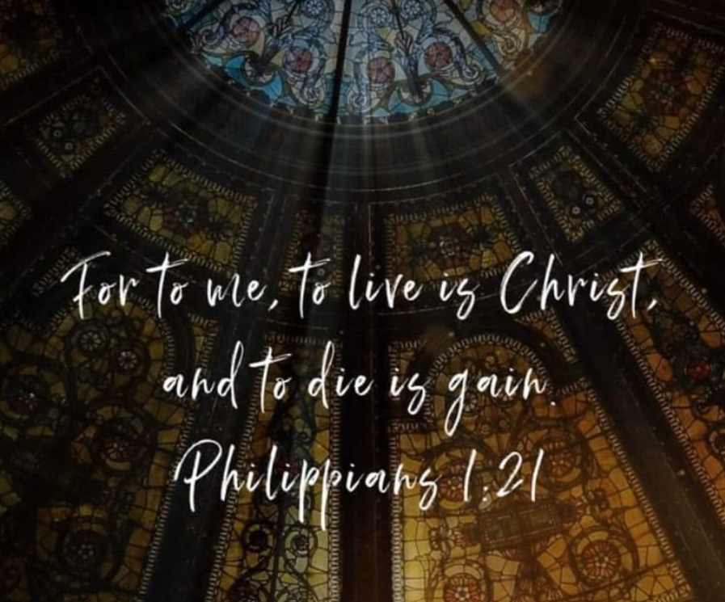

Slide 93
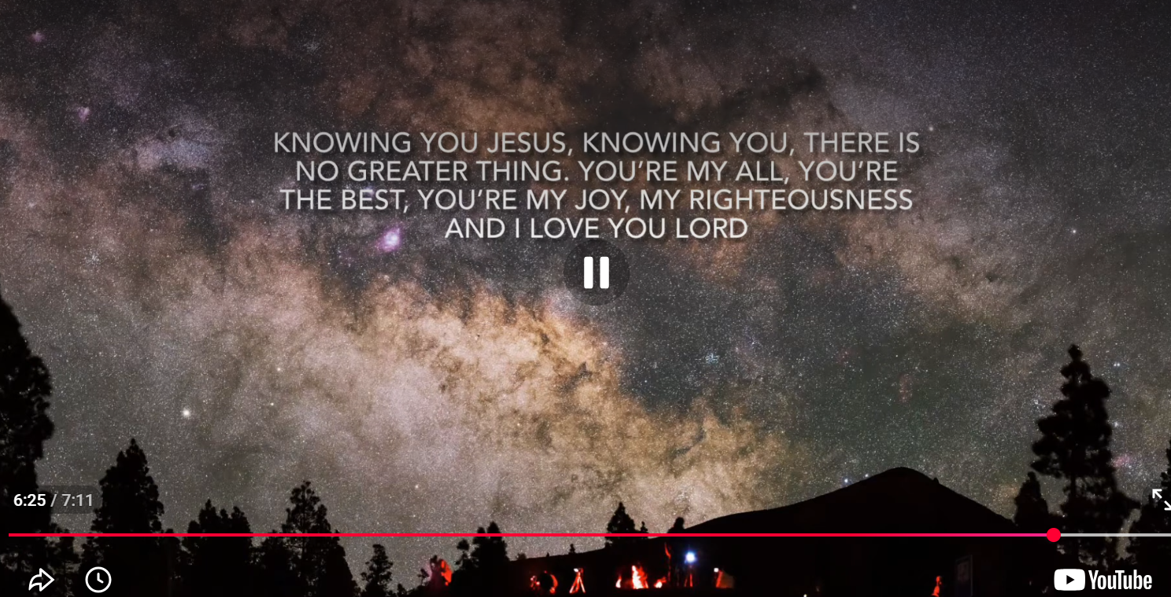
The paraphrased Word
The remembered Word
The poeticized Word
“The Word, the Word, the Word”

Slide 94
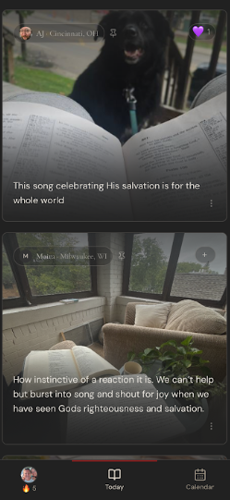
“Open Book”
It tells you where to turn in Scripture.
It offers brief commentary.
It poses a question.
You take a picture with your Bible open and the setting of your devotion.

Slide 95
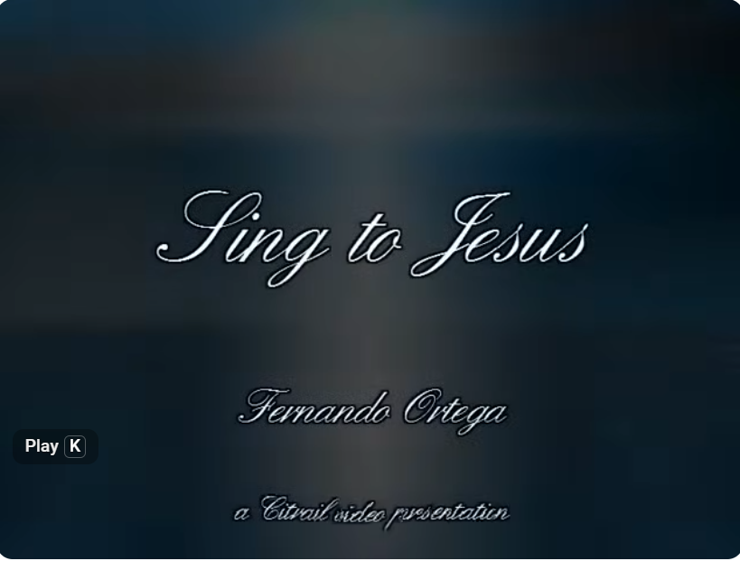

Slide 96

IVA
Identify
What feelings are present?
Validate
It’s only human to feel these things
Align
Now, What’s True?
Lord, things will happen to me today, some I can control, most I cannot. But you are sovereign, Lord. Nothing will happen to me today that you don’t already know about. So when an event occurs, help me to capture my thoughts with your promise that you will never leave me or forsake me and your promise that you are working all things, including this event, for my good. Let these promises give me feelings of peace, hope, and joy that my behavior honors you in all things.

Slide 97
Closing Remarks
“From the fullness of the heart…”

Slide 98
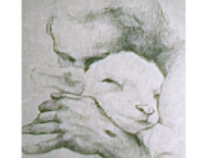
Closing Remarks
“The desired end is brought about by our becoming again ever more deeply absorbed in the gospel – not letting go until it blesses.” – JP Koehler

Slide 99
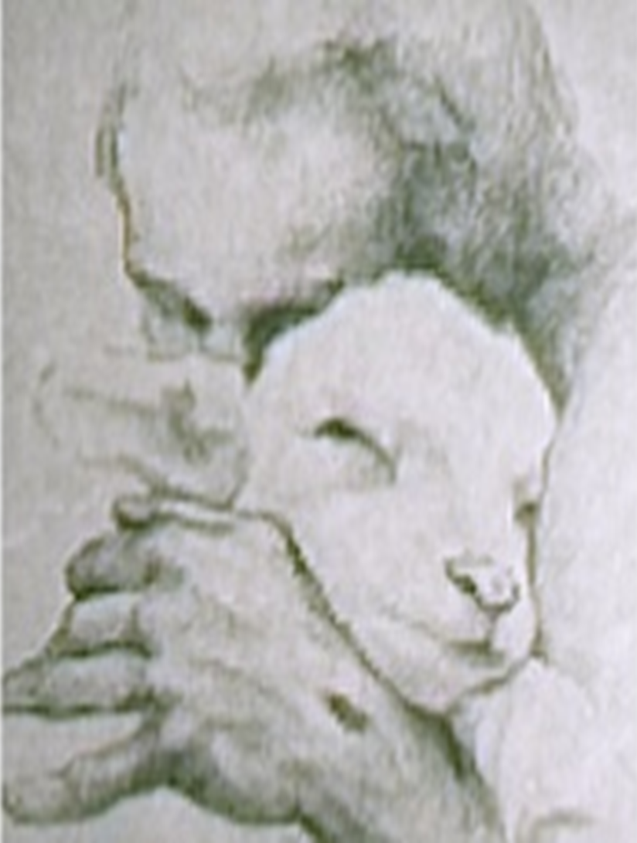
Closing Remarks
CS Lewis: “I believe in Jesus like I believe in the sun. I not only see it. I see everything else by it.”
GK Chesterton: “Allow one sun in your sky, one mystery too bright to look into, and all else is lit up in that light.”

Slide 100
Closing Remarks
“What good would it do me to construct a world in which I did not live, but only held up to the view of others?” Soren Kierkegaard

Slide 101
Closing Remarks
“Speak a Word of Christ then leave them alone. Trust the two of them to work it out.” Soren Kierkegaard

Slide 102
Closing Remarks
“Speak to Christ about the man even more than you speak to the man about Christ.” Dietrich Bonhoeffer

Slide 103
Closing Remarks
God, grant to each…
a full heart
a ready Word
a transparently Christian life
a love like his

Slide 104
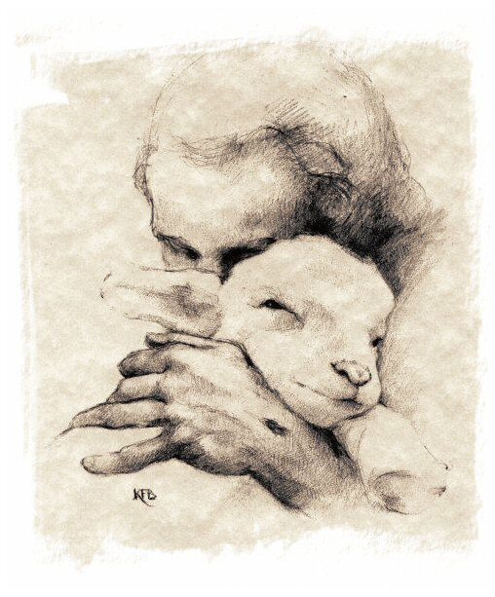

Slide 107
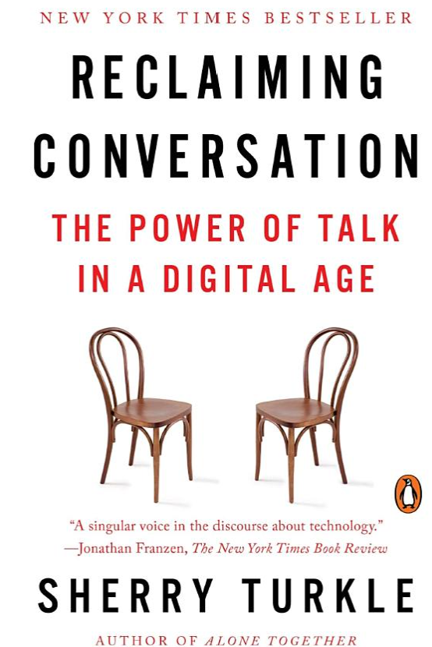

Slide 108
1 Corinthians
¹⁸ For the message of the cross is foolishness to those who are perishing, but to us who are being saved it is the power of God. ¹⁹ For it is written:
“I will destroy the wisdom of the wise;
the intelligence of the intelligent I will frustrate.”
²⁰ Where is the wise person? Where is the teacher of the law? Where is the philosopher of this age? Has not God made foolish the wisdom of the world? ²¹ For since in the wisdom of God the world through its wisdom did not know him, God was pleased through the foolishness of what was preached to save those who believe. ²² Jews demand signs and Greeks look for wisdom, ²³ but we preach Christ crucified: a stumbling block to Jews and foolishness to Gentiles, ²⁴ but to those whom God has called, both Jews and Greeks, Christ the power of God and the wisdom of God. ²⁵ For the foolishness of God is wiser than human wisdom, and the weakness of God is stronger than human strength.

Slide 109
Closing Remarks
Martin Luther: “See a man captivated by
the cross”
Siegbert Becker: “I only have the gospel.”
CS Lewis: “God in the Dock”
Martin Luther: “The Three Lights”
Tullian Tchividjian: “The Last Idol to Fall”
Yours truly: “If it seems a weak thing…”

